Slide 1
Starcraft 2 Player Classification
Andrew Smith
North Star Consulting

Slide 2
Introduction
Starcraft 2
Science Fiction RTS (Real Time Strategy)
Thousands of active players
Global Tournaments
Seasonal Ladder

Slide 3
League Tiers
Bronze (22.5%)
Silver (34%)
Gold (22.8%)
Grandmaster (Top 200 Players, 0.6%)
Platinum (8.7%)
Diamond (9.5%)
Master (1.8%)
Beginner
Advanced
Expert

Slide 4
Features
APM (Actions Per Minute)
PAC (Perception Action Cycle)
Number of PACs
Gap Between PACs
Average Actions in PAC
Action Latency (Milliseconds between moving and taking an action)
Hotkey Usage
Number of Units Selected via Hotkey
Average Number of Units Assigned to Hotkeys
Number of Unique Hotkeys Used
Minimap Usage
Number of Attack Actions on Minimap
Number of Right-Clicks on Minimap
Player Age
Average Hours Played Per Week
Total Hours Played
Map Exploration
Units Creation
Workers Created
Unique Units Created
Complex Units Created
Complex Unit Abilities Used

Slide 5
Methodology
Format Data
Normalize Data
Test Various Models
Fine Tune Best Model

Slide 6
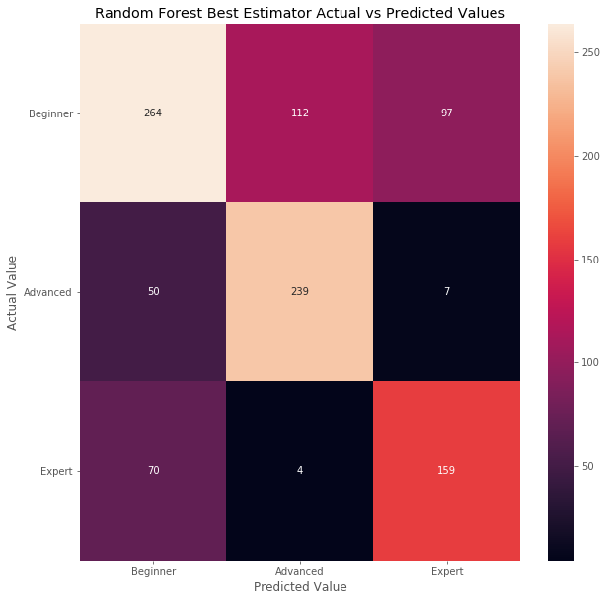
Results
Best Model: Random Forest
Accuracy: 66%
Most Misclassifications Related to Beginner Tier
Likely Due to Play Time vs Player Skill Level

Slide 7
Future Work
Improve Model Accuracy
Reduce Weight of Hours Played
League Classification Models
Return Three Tiers to Original Seven Leagues

Slide 8
Thank You! Any Questions?
Data Source: SkillCraft-Starcraft Database on Kaggle https://www.kaggle.com/danofer/skillcraft/data#SkillCraft.csv

